Slide 1


Lecture 7
Produced by Dr. Worldwide
Welcome to the 305
~
~

Slide 2

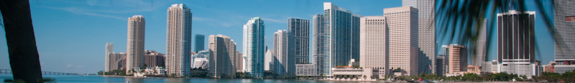
Ex: Investment
Investor Kathy Allen has $70,000 to divide across multiple investments
Municipal bonds with 8.5% return
Certificate of deposit with 5% return
Treasury bills with 6.5% return
Growth stock with 13% return
Q: How much should Kathy invest to maximize return?
Guidelines for diversification
No more than 20% of the total investment should be in municipal bonds
Amount invested in CDs shouldn’t exceed amount invested in the rest
At least 30% of the investment should be in treasury bills and CDs
More invested in CDs & treasury bills than in the other two by a ratio of at least 1.2 to 1
Kathy wants to invest the entire $70,000

Slide 3
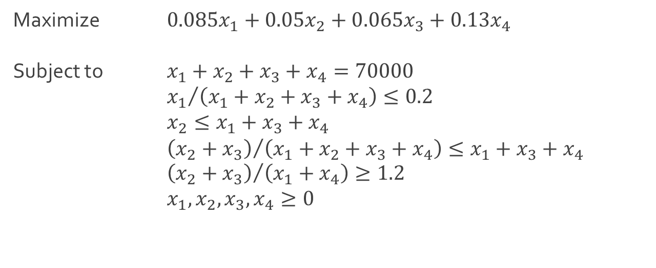
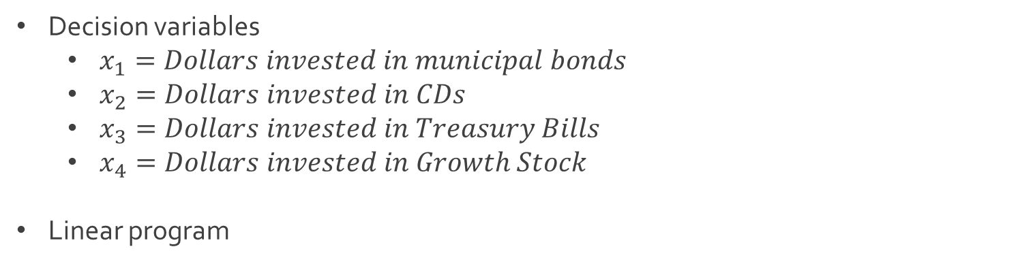
Ex: Investment
Decision variables
$x_{1}=Dollars invested in municipal bonds$
$x_{2}=Dollars invested in CDs$
$x_{3}=Dollars invested in Treasury Bills$
$x_{4}=Dollars invested in Growth Stock$
Linear program
Maximize $0.085x_{1}+0.05x_{2}+0.065x_{3}+0.13x_{4}$
Subject to $x_{1}+x_{2}+x_{3}+x_{4}=70000$
${x_{1}}/{\left(x_{1}+x_{2}+x_{3}+x_{4}\right)}≤0.2$
$x_{2}≤x_{1}+x_{3}+x_{4}$
${\left(x_{2}+x_{3}\right)}/{\left(x_{1}+x_{2}+x_{3}+x_{4}\right)}≤x_{1}+x_{3}+x_{4}$
${\left(x_{2}+x_{3}\right)}/{\left(x_{1}+x_{4}\right)}≥1.2$
$x_{1},x_{2},x_{3},x_{4}≥0$

Slide 4
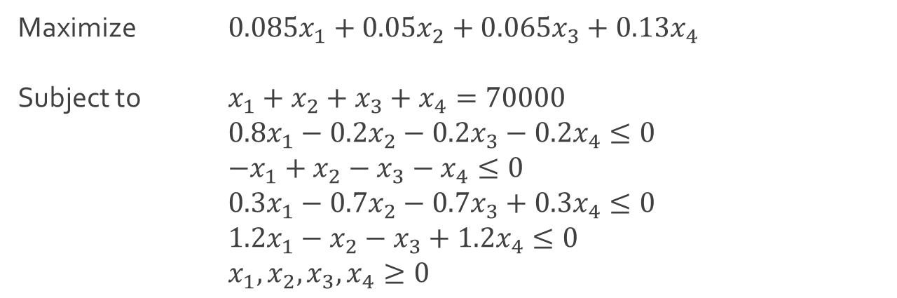

Ex: Investment
Linear program in standard form
Download Investment-1.xlsx from course website from link Sheet 1
Optimal solution $\left(x_{1},x_{2},x_{3},x_{4}\right)=(0,0,38181,3181.18)$
Maximize $0.085x_{1}+0.05x_{2}+0.065x_{3}+0.13x_{4}$
Subject to $x_{1}+x_{2}+x_{3}+x_{4}=70000$
$0.8x_{1}−0.2x_{2}−0.2x_{3}−0.2x_{4}≤0$
$−x_{1}+x_{2}−x_{3}−x_{4}≤0$
$0.3x_{1}−0.7x_{2}−0.7x_{3}+0.3x_{4}≤0$
$1.2x_{1}−x_{2}−x_{3}+1.2x_{4}≤0$
$x_{1},x_{2},x_{3},x_{4}≥0$

Slide 5
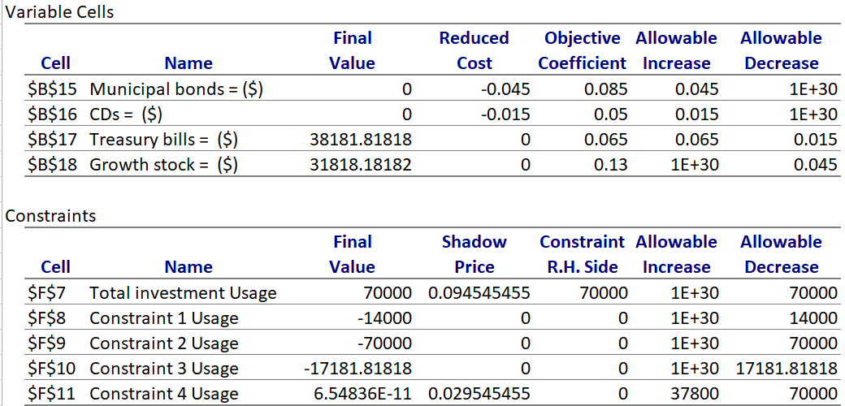
Ex: Investment
Sensitivity analysis

Slide 6
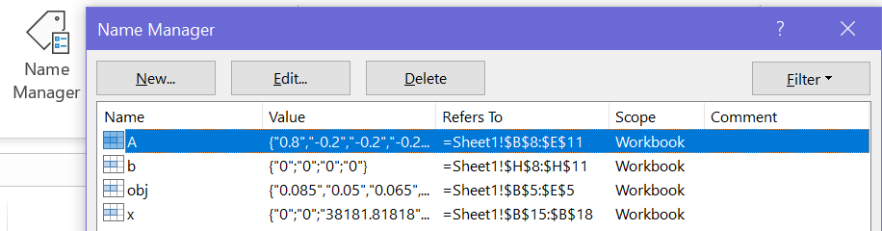
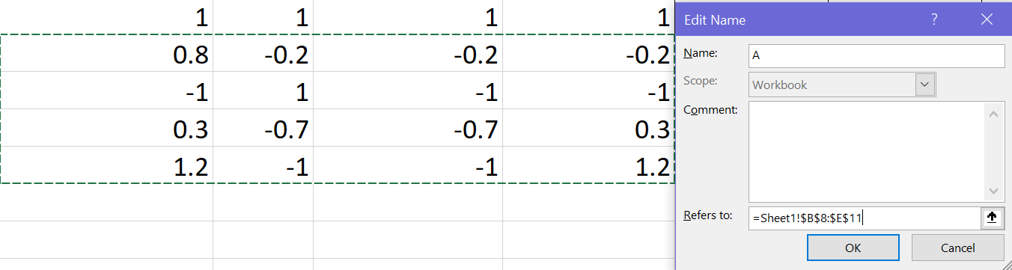
Ex: Investment
Created variables

Slide 7
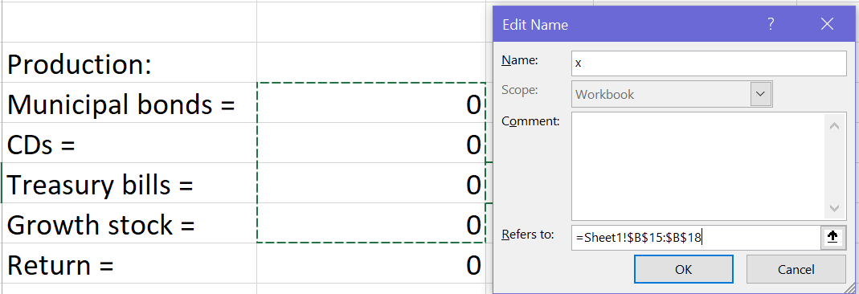
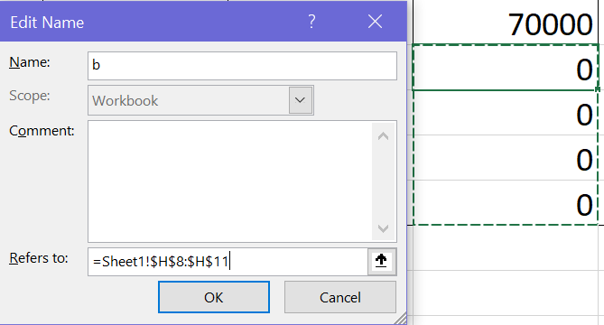
Ex: Investment
Created variables

Slide 8
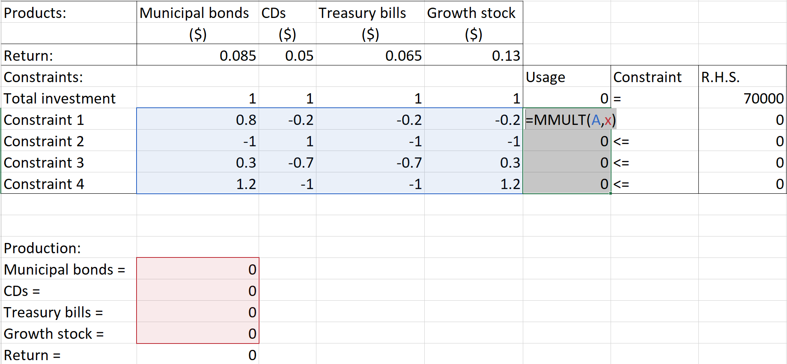
Ex: Investment
Usage of variables

Slide 9
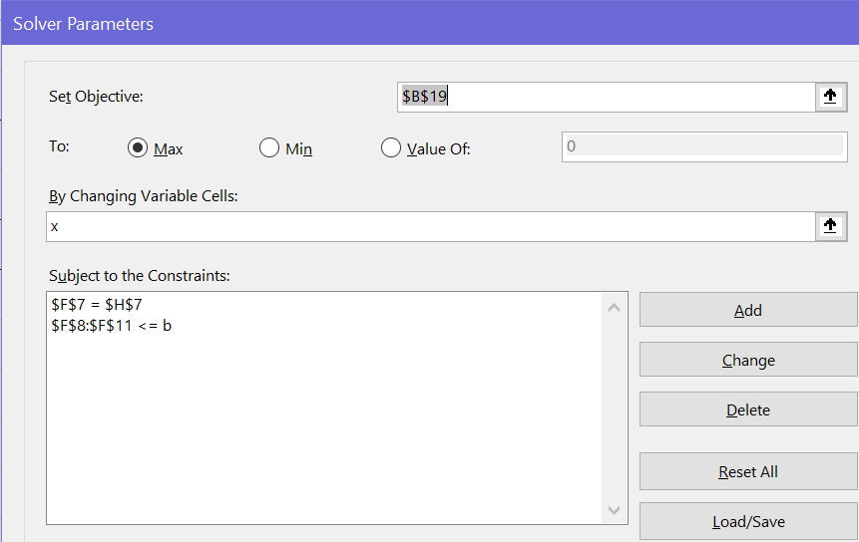
Ex: Investment
Usage of variables
Q: What other variable was created and how is it being used?

Slide 10
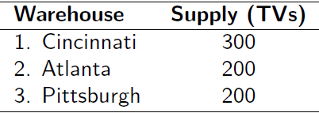
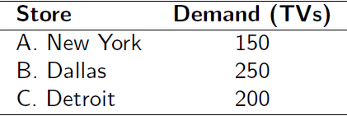
Ex: Transportation
Best Boy retail chain ships televisions from 3 of its distribution warehouses to three of its retail stores monthly
Each warehouse has a fixed supply per month and fixed demand per month
Q: How many TVs should be shipped from each warehouse to each store to minimize the total cost of transportation?
Supply (700 TVs) and Demand (600 TVs)

Slide 11
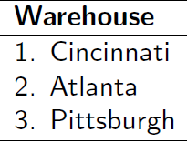
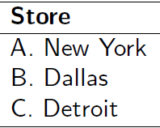
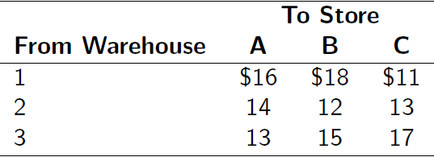
Ex: Transportation
Shipping cost per TV for each route

Slide 12
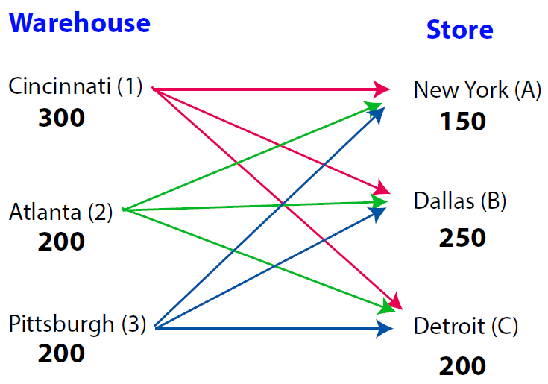
Ex: Transportation
Visual of all routes (supply > demand)

Slide 13
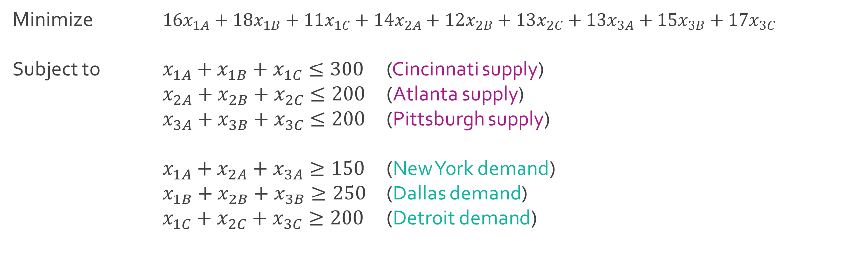
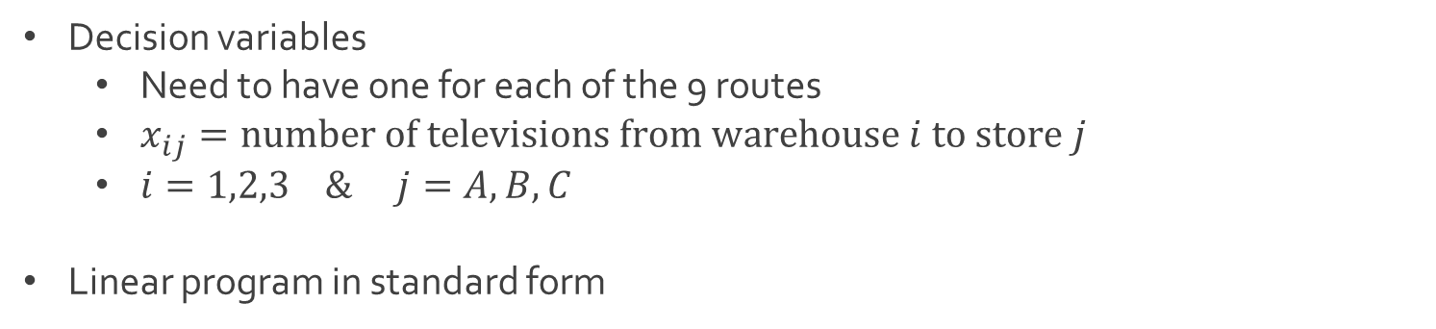
Ex: Transportation
Decision variables
Need to have one for each of the 9 routes
$x_{ij}=number of televisions from warehouse i to store j$
$i=1,2,3 \& j=A,B,C$
Linear program in standard form
Minimize $16x_{1A}+18x_{1B}+11x_{1C}+14x_{2A}+12x_{2B}+13x_{2C}+13x_{3A}+15x_{3B}+17x_{3C}$
Subject to $x_{1A}+x_{1B}+x_{1C}≤300$ (Cincinnati supply)
$x_{2A}+x_{2B}+x_{2C}≤200$ (Atlanta supply)
$x_{3A}+x_{3B}+x_{3C}≤200$ (Pittsburgh supply)
$x_{1A}+x_{2A}+x_{3A}≥150$ (New York demand)
$x_{1B}+x_{2B}+x_{3B}≥250$ (Dallas demand)
$x_{1C}+x_{2C}+x_{3C}≥200$ (Detroit demand)

Slide 14
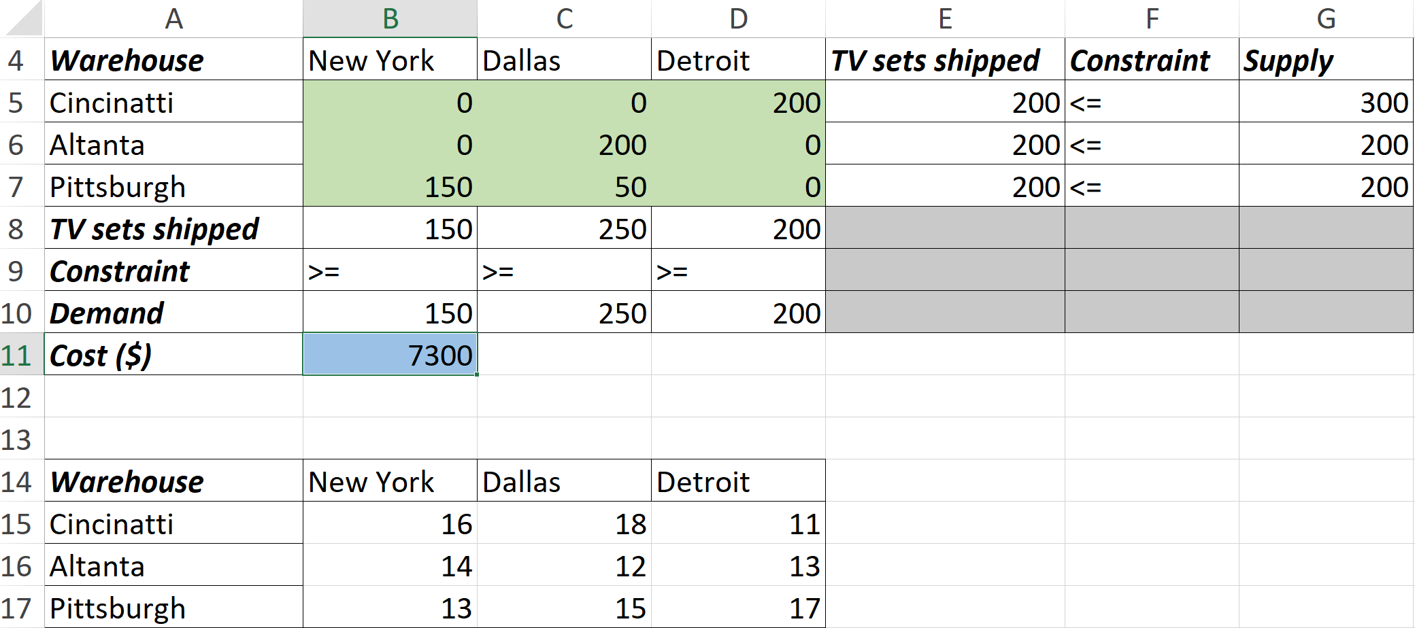
Ex: Transportation
Download Transportation-1.xlsx from course website from link Sheet 2
Sheet called Standard contains the standard linear program format and the sheet called Alternative contains a more compact form of the same linear program
Focus on Alternative sheet

Slide 15
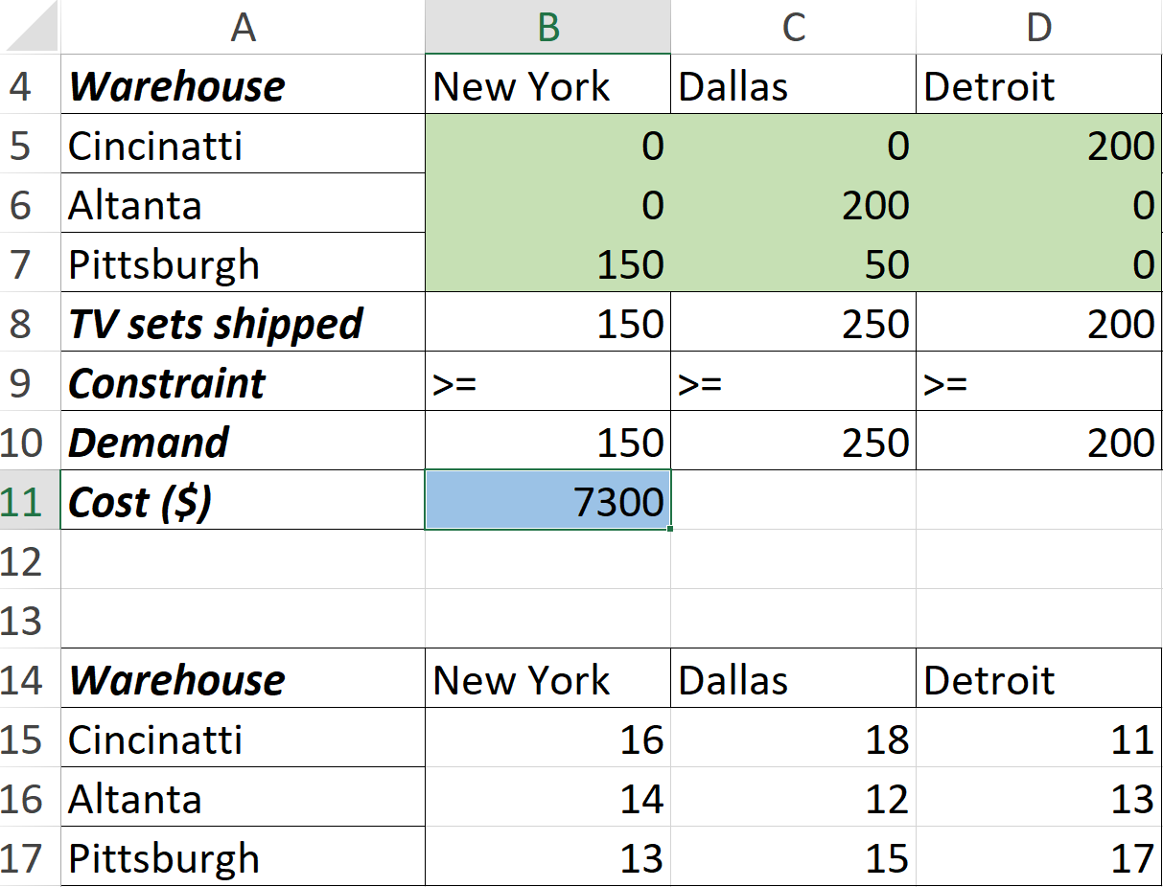
Ex: Transportation
Use of SUMPRODUCT in creation of objective function
=SUMPRODUCT(B5:D7, B15,D17)

Slide 16

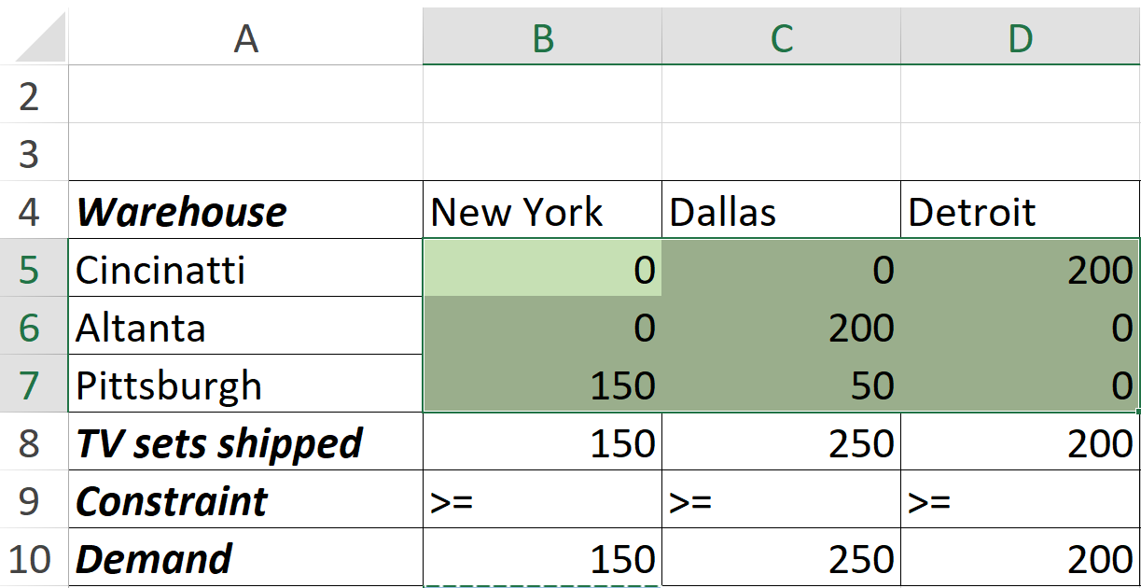
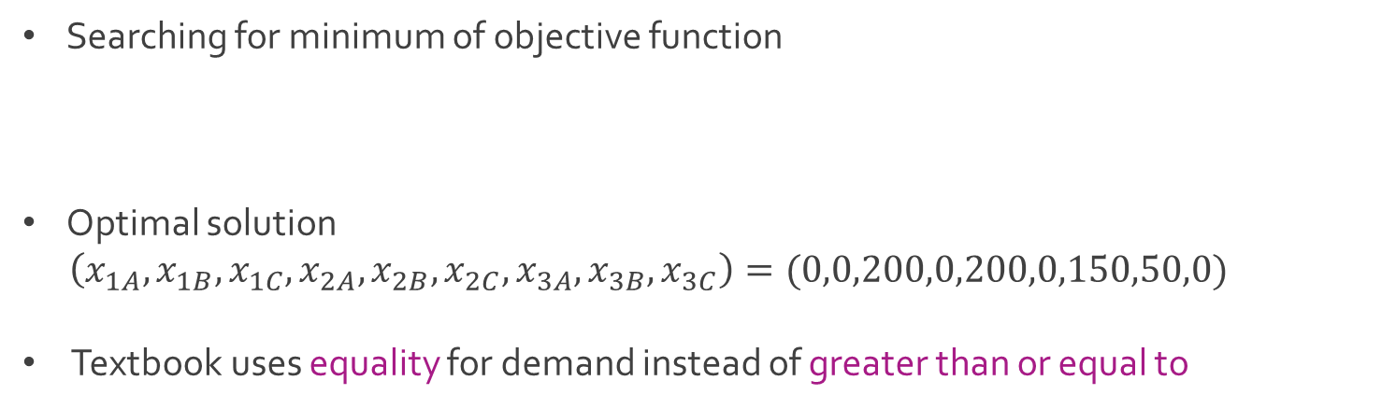
Ex: Transportation
Searching for minimum of objective function
Optimal solution
$\left(x_{1A},x_{1B},x_{1C},x_{2A},x_{2B},x_{2C},x_{3A},x_{3B},x_{3C}\right)=(0,0,200,0,200,0,150,50,0)$
Textbook uses equality for demand instead of greater than or equal to

Slide 17
Ex: Scheduling
PM Computers assembles its own brand of laptops from component parts purchased overseas and domestically
Most computers sold locally to the university, individuals, and businesses
PM has production capacity to produce 160 computers per week with an additional 50 computers with overtime
Cost per computer is $190 during regular time and $260 during overtime
Additionally, it costs $10 per computer per week to hold a computer in inventory for future delivery
PM wants to meet all customer orders with no shortages and quality service

Slide 18
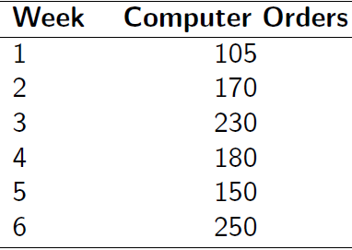
Ex: Scheduling
Order schedule for the next 6 weeks
Q: How much regular time and overtime production is needed each week to meet its orders at the minimum total production cost?

Slide 19
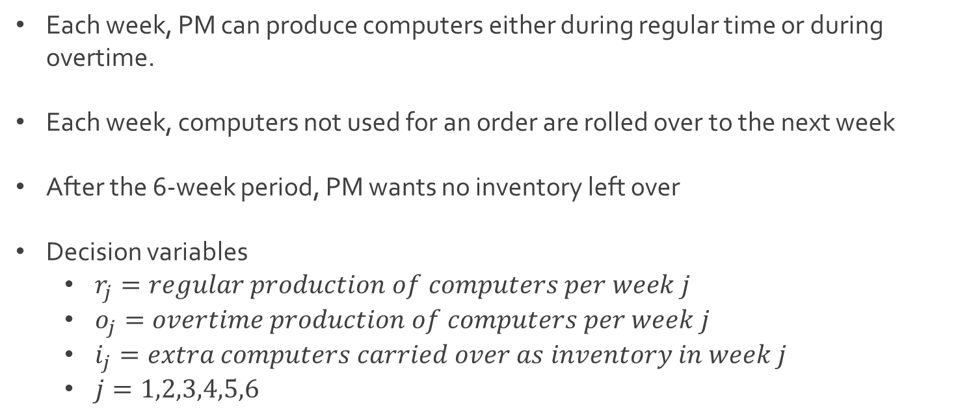
Ex: Scheduling
Each week, PM can produce computers either during regular time or during overtime.
Each week, computers not used for an order are rolled over to the next week
After the 6-week period, PM wants no inventory left over
Decision variables
$r_{j}=regular production of computers per week j$
$o_{j}=overtime production of computers per week j$
$i_{j}=extra computers carried over as inventory in week j$
$j=1,2,3,4,5,6$

Slide 20
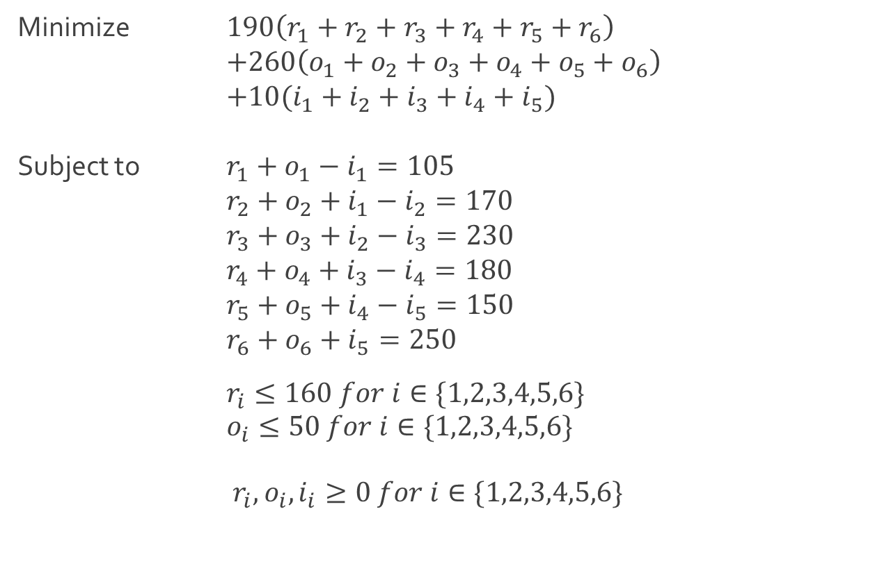
Ex: Scheduling
Linear program in standard form
Minimize $190\left(r_{1}+r_{2}+r_{3}+r_{4}+r_{5}+r_{6}\right)$
$+260\left(o_{1}+o_{2}+o_{3}+o_{4}+o_{5}+o_{6}\right)$
$+10(i_{1}+i_{2}+i_{3}+i_{4}+i_{5})$
Subject to $r_{1}+o_{1}−i_{1}=105$
$r_{2}+o_{2}+i_{1}−i_{2}=170$
$r_{3}+o_{3}+i_{2}−i_{3}=230$
$r_{4}+o_{4}+i_{3}−i_{4}=180$
$r_{5}+o_{5}+i_{4}−i_{5}=150$
$r_{6}+o_{6}+i_{5}=250$
$r_{i}≤160 for i∈\{1,2,3,4,5,6\}$
$o_{i}≤50 for i∈\{1,2,3,4,5,6\}$
$r_{i},o_{i},i_{i}≥0 for i∈\{1,2,3,4,5,6\}$

Slide 21
Ex: Scheduling
Download Multischedule-1.xlsx from course website from link Sheet 3
Sheet called Standard contains the standard linear program format and the sheet called Alternative contains a more compact form of the same linear program
From Standard, see the following solution from Excel Solver
Try to acquire the same solution from the Alternative format
 | Week 1 | Week 2 | Week 3 | Week 4 | Week 5 | Week 6
Regular | 160 | 160 | 160 | 160 | 160 | 160
Overtime | 0 | 0 | 25 | 20 | 30 | 50
Inventory | 55 | 45 | 0 | 0 | 40
Total | 160 | 215 | 230 | 180 | 190 | 250
Required | 105 | 170 | 230 | 180 | 150 | 250

Slide 22




The End
Dale

